Slide 1

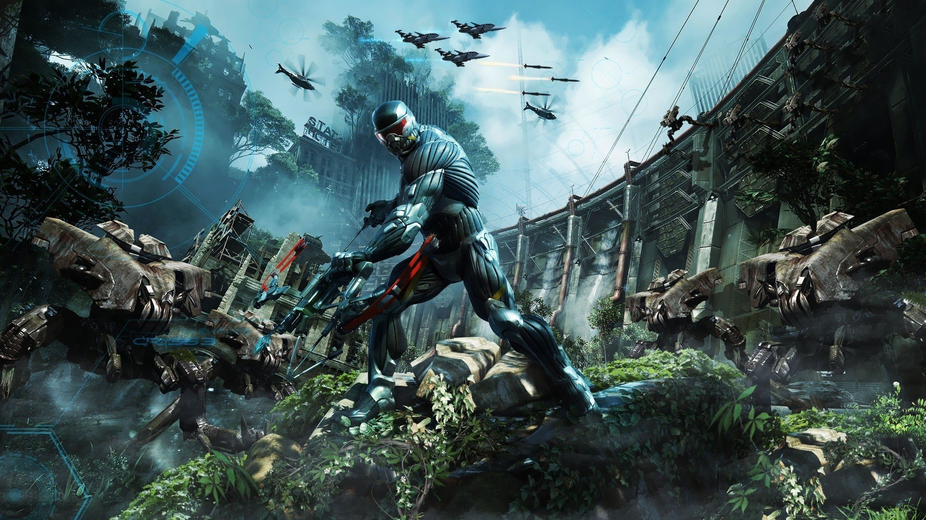
Game (Oyin)

Slide 2
Game (oyin) Call Of Duty

Slide 3
Counter Strike

Slide 4
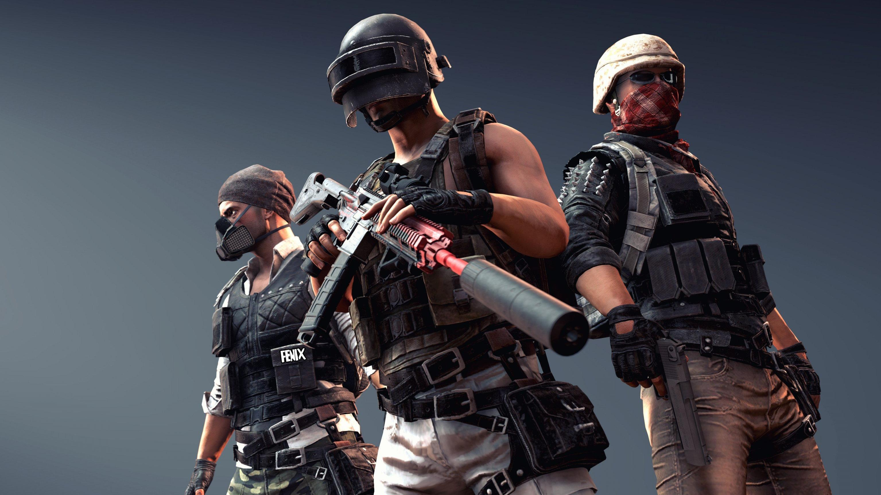
PUBG

Slide 5
Subwey Surfers

Slide 6
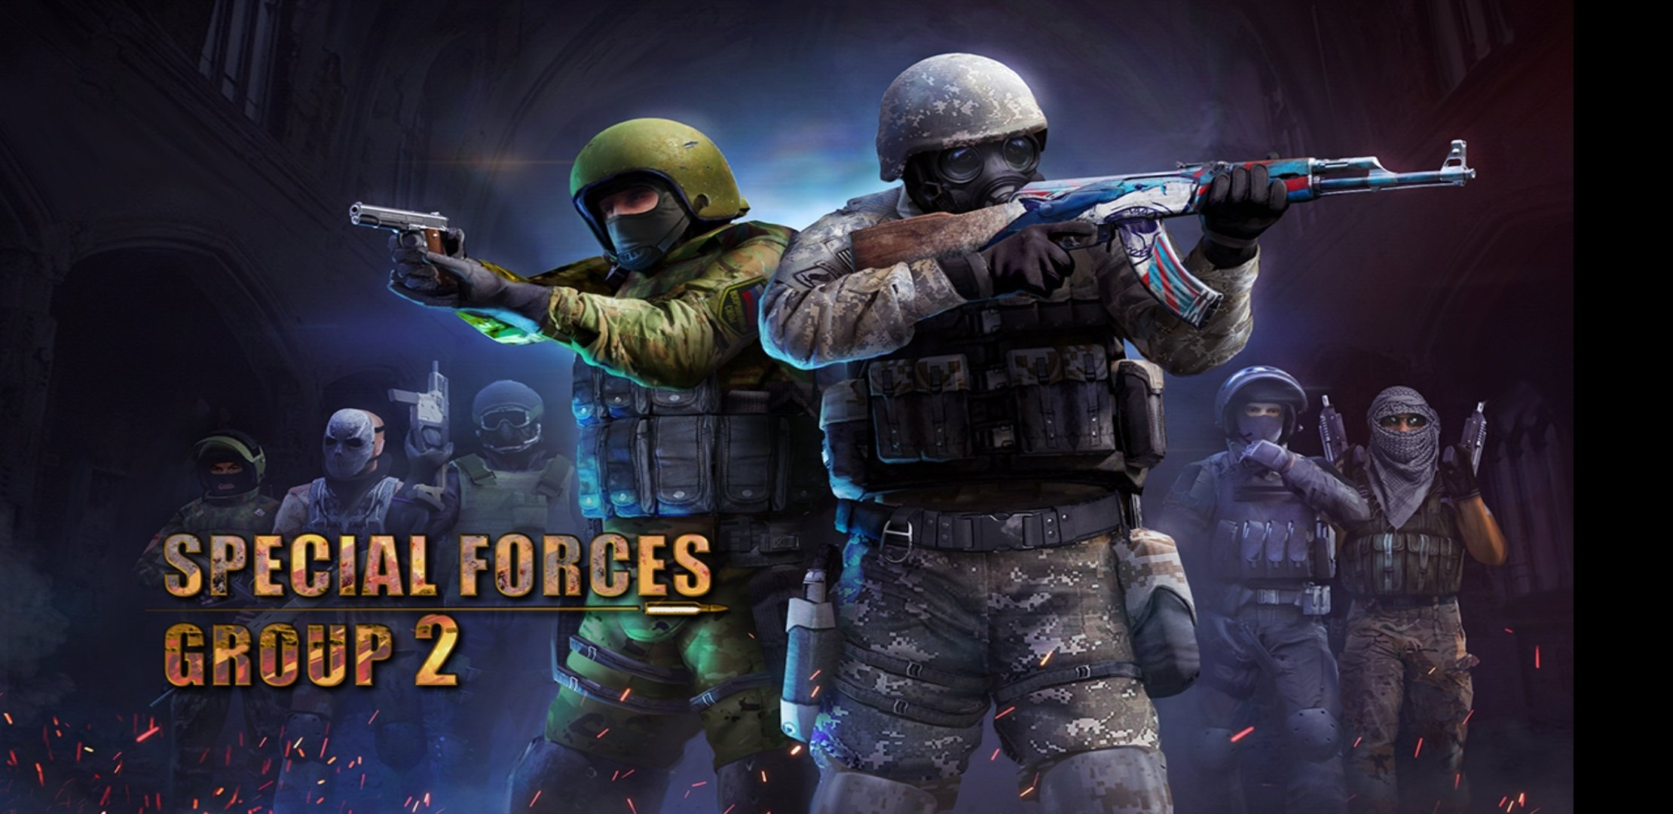
Special Forces Group 2

Slide 7

Fortinite

Slide 8
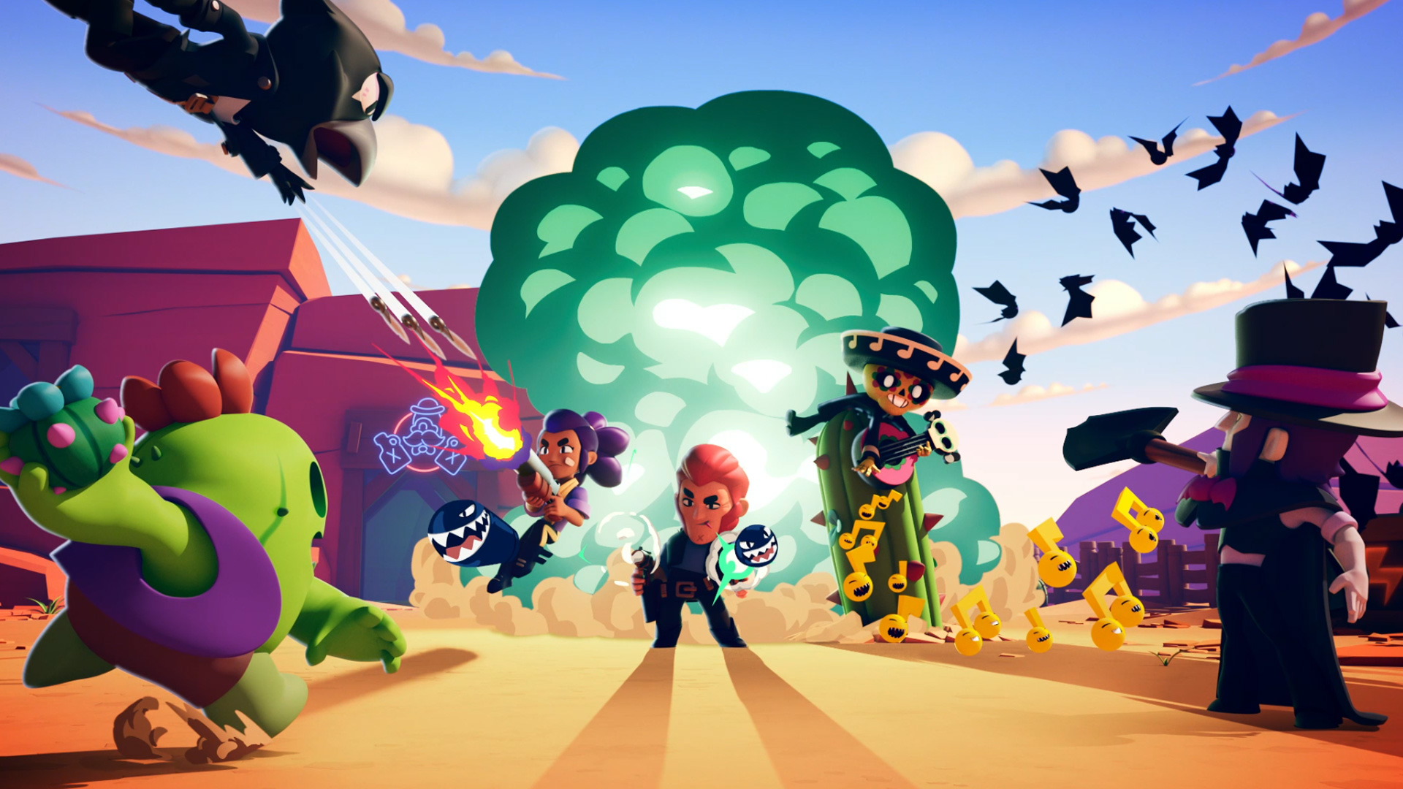
Brawl Stars

Slide 9

Zombie catchers

Slide 10

Minecraft

Slide 11

FIFA 21

Slide 12

UFC

Slide 13

Asphalt

Slide 14
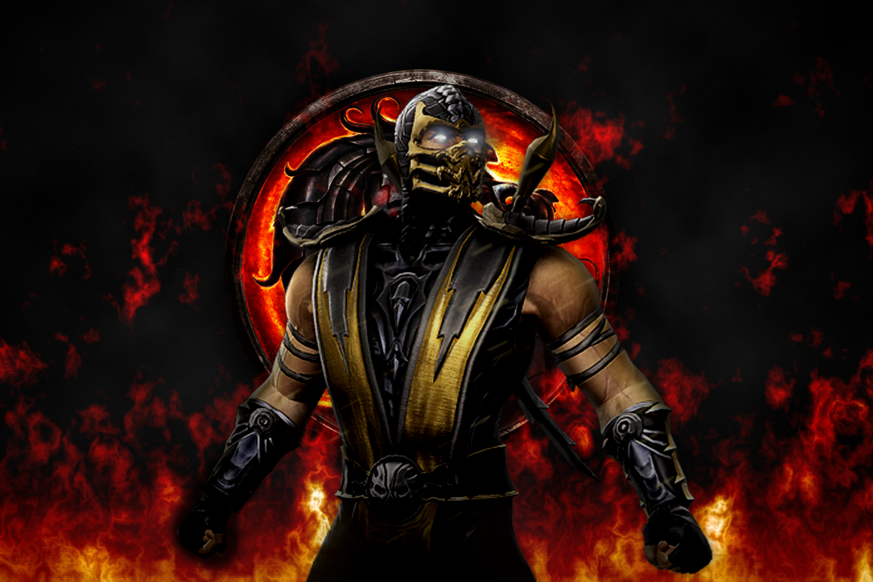
Mortal Kombat

Slide 15

Need For Speed

Slide 16
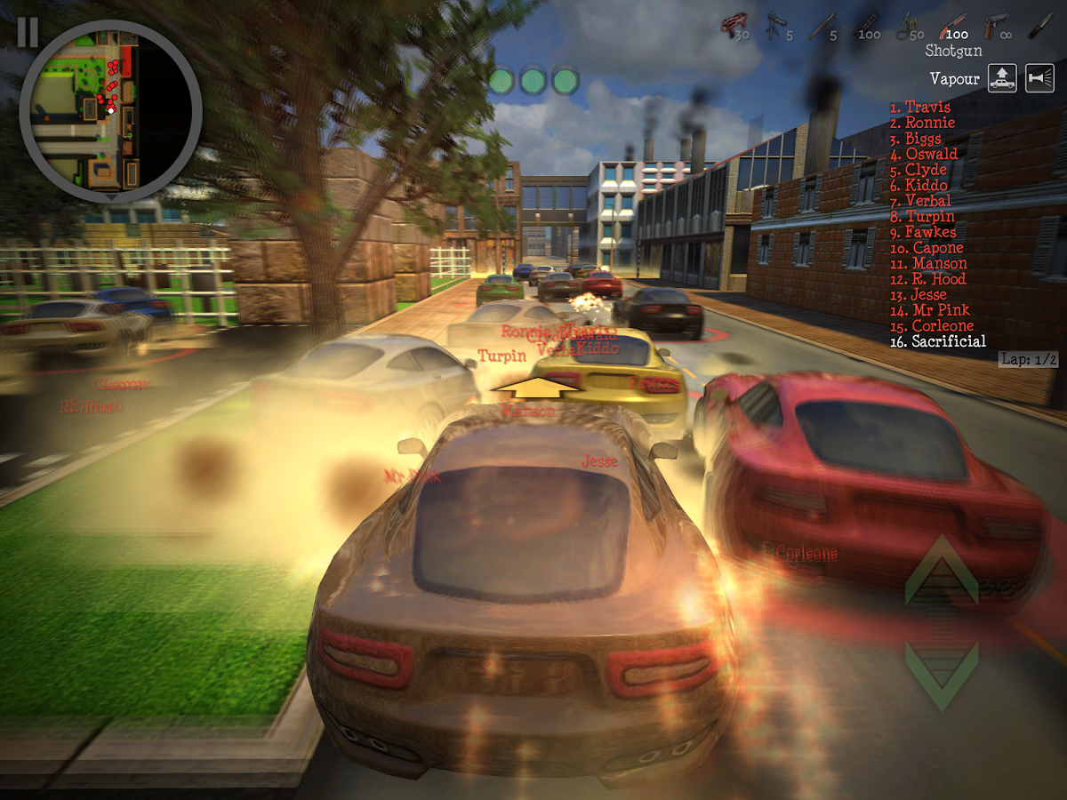
Payback

Slide 17

Standoff

Slide 18
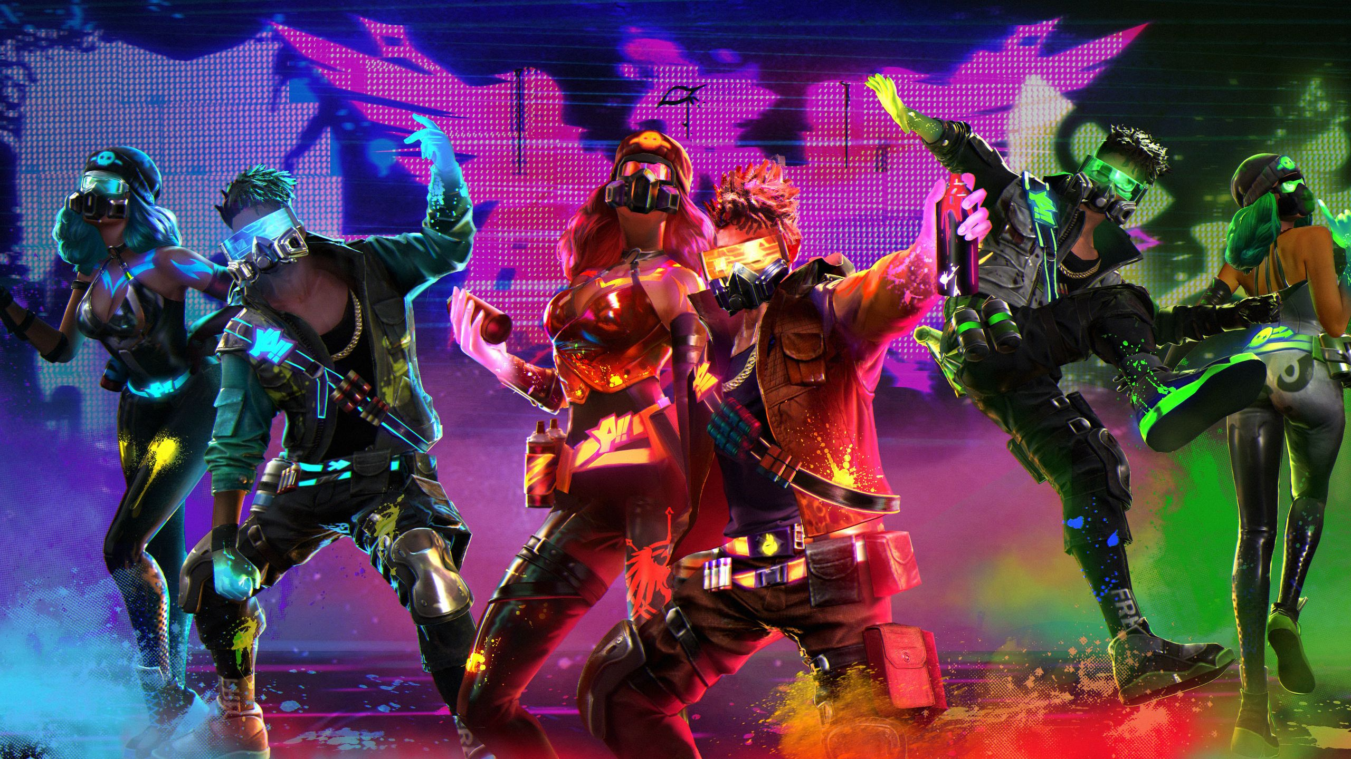
Free fire

Slide 19

Mafia

Slide 20
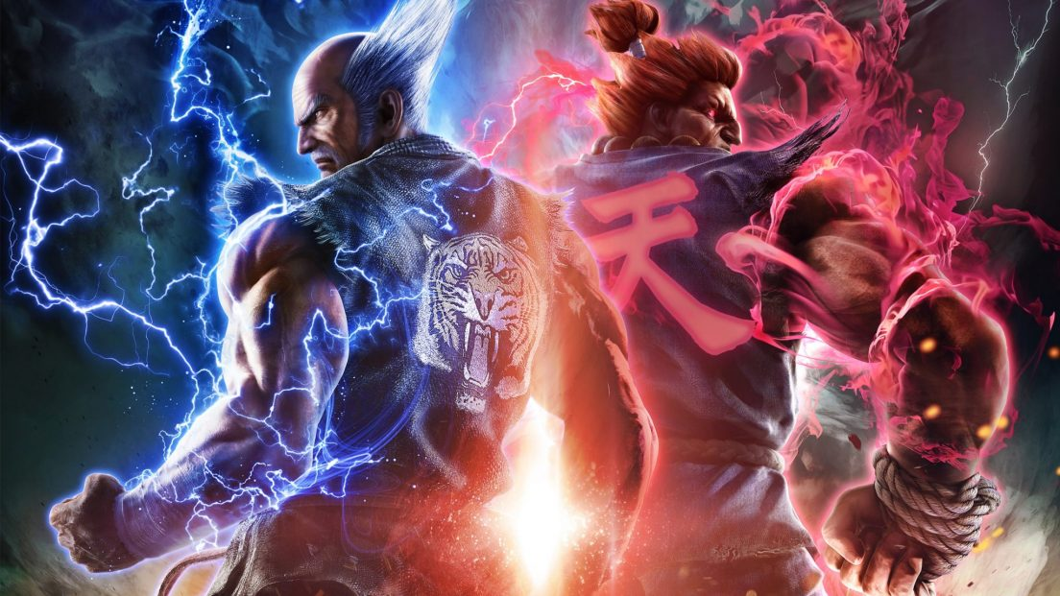
Tekken 7

Slide 21

Candy Crush

Slide 22
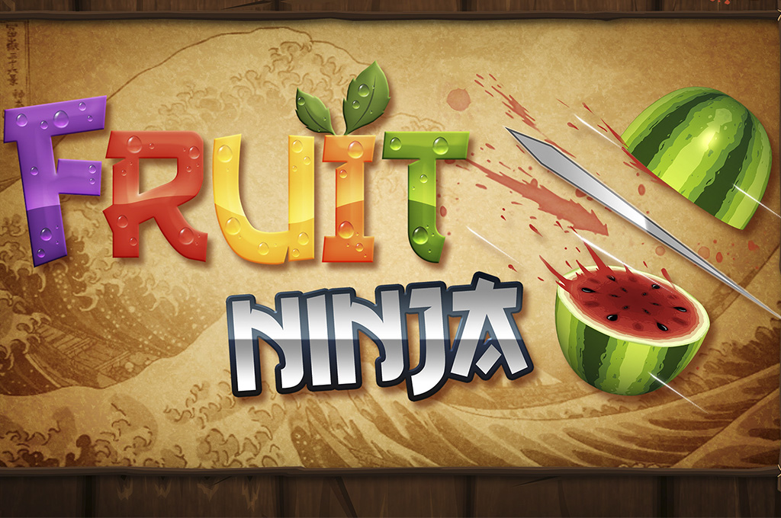
Fruit Ninja

Slide 23
GTA

Slide 24

Clash Mobile

Slide 25
Shadow Fight

Slide 26

My Talking Tom

Slide 27

Vector

Slide 28

Stickman Party

Slide 29

Assasin Creets

Slide 30
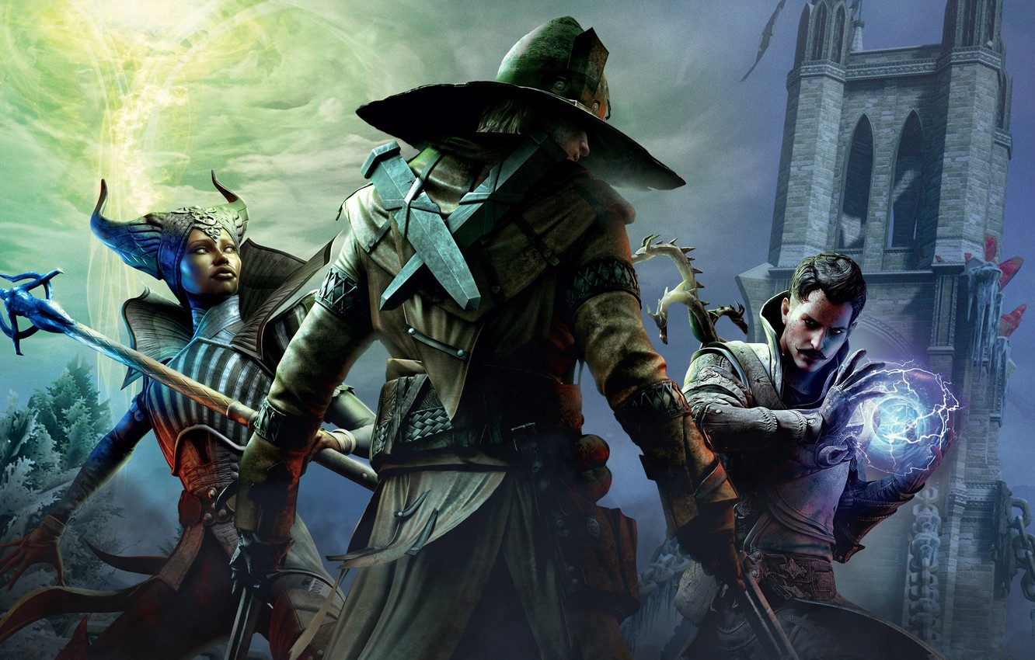
Dragon Age

